Slide 1
Cuda-mediated Maze generation

Slide 2
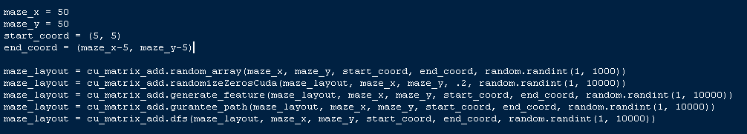
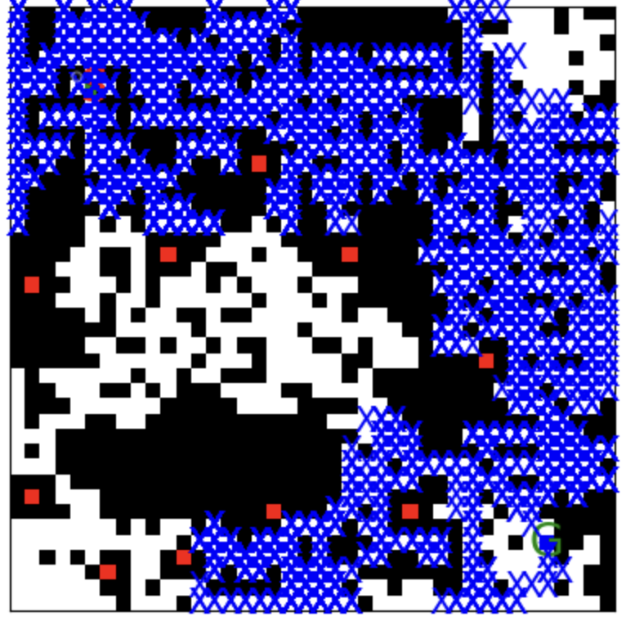
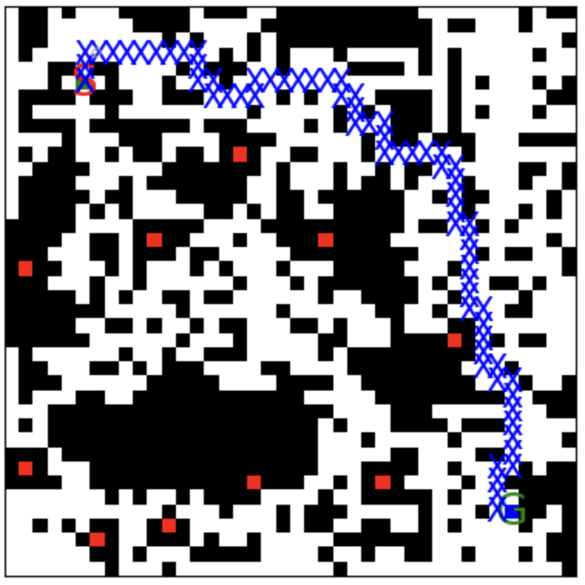
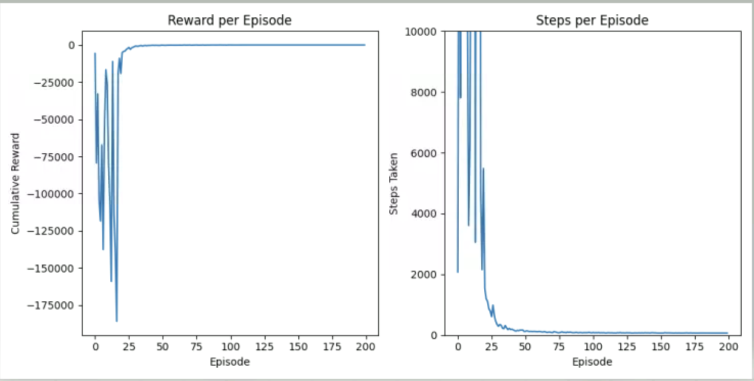
Background & Features
Q-learning and reinforcement learning are widespread methods used in machine learning
In order to test and train model, multiple scenarios with random features must be used
Can be time consuming and biased when person designs test mazes by hand
Needed to find a way to quickly and efficiently design mazes with random features that would reliably produce solvable outputs
Solution was to create a modular pipeline that could be adjusted and fine-tuned by the user

Slide 3
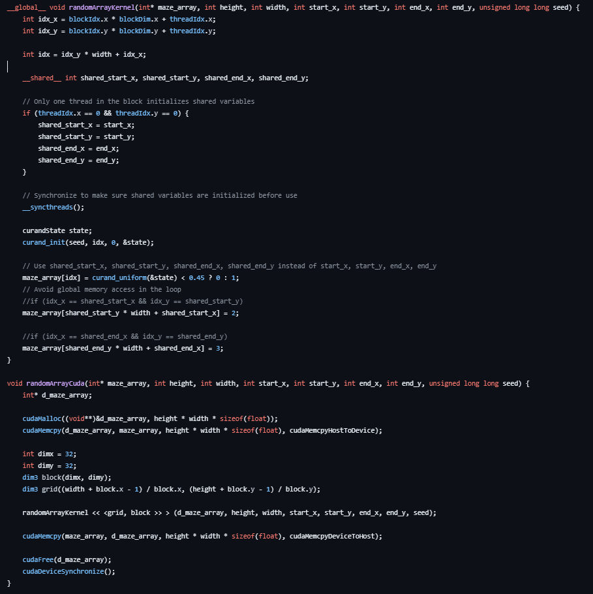
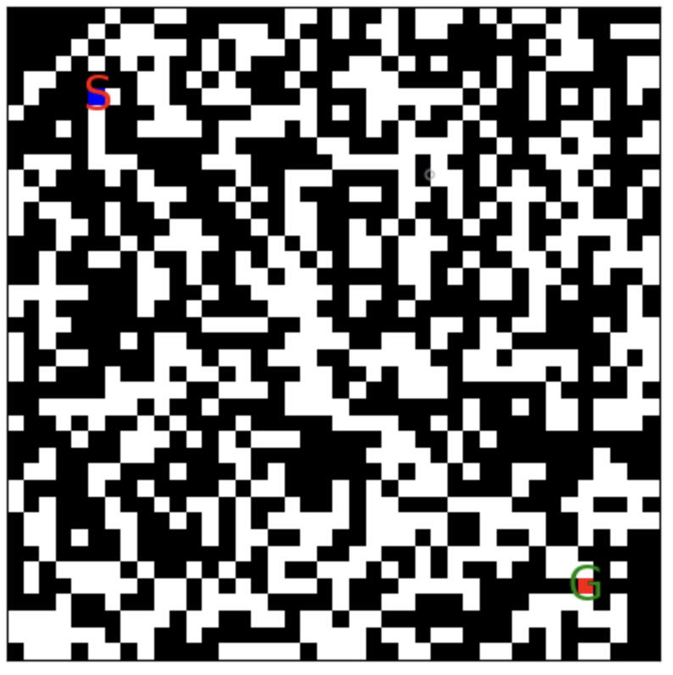
Step 1: Random number array
Random number array is generated by using curand_uniform to generate random value to determine if index in array should be 0 (open space) or 1 (wall)
Kernel saves starting and end location in shared memory
Refers to them when setting start and stop locations in maze

Slide 4
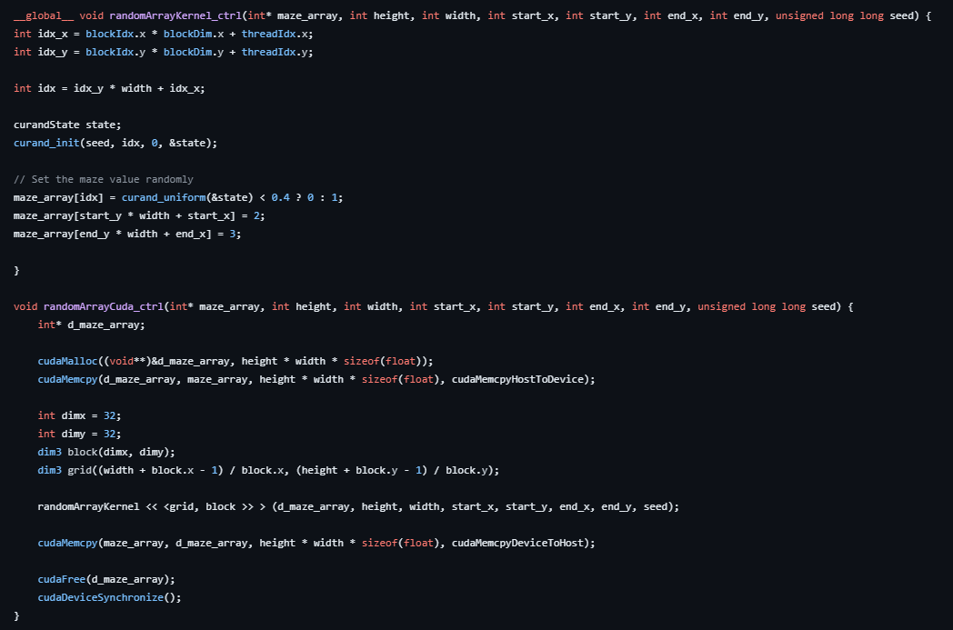
Step 1a: Random number array - control
Does not utilize shared memory

Slide 5
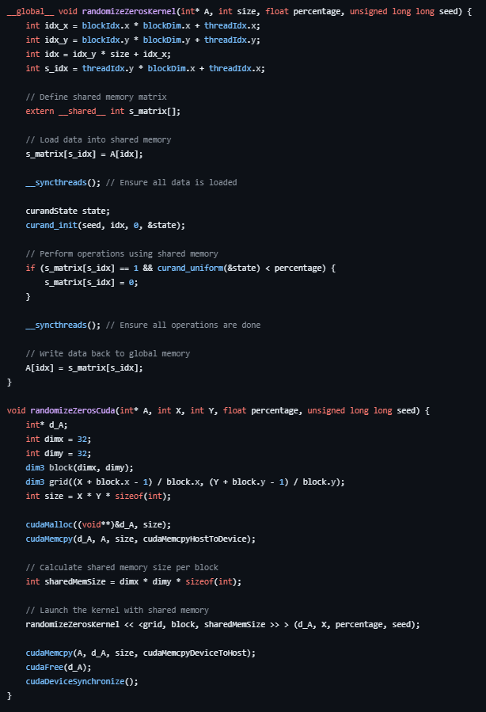
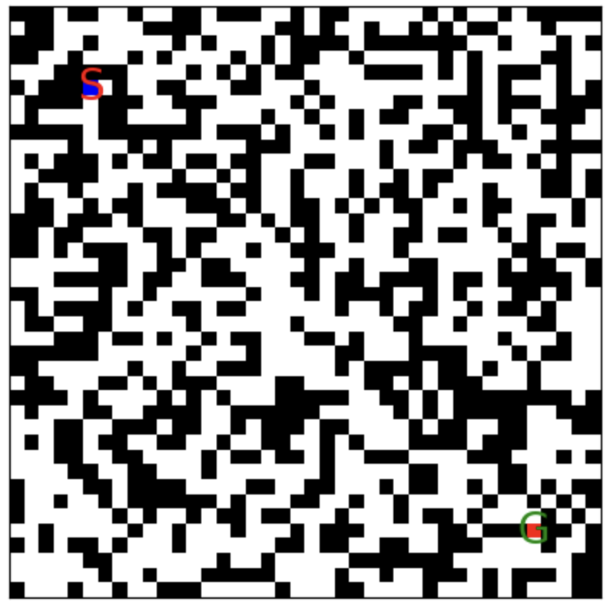
Step 2: Array Randomizer
Kernel modifies already existing array by copying inputted matrix to shared memory and then applying randomizer to array saved in shared memory.
Array is copied to inputted array after randomizer is complete
Shared array uses same dimensions as input array A

Slide 6
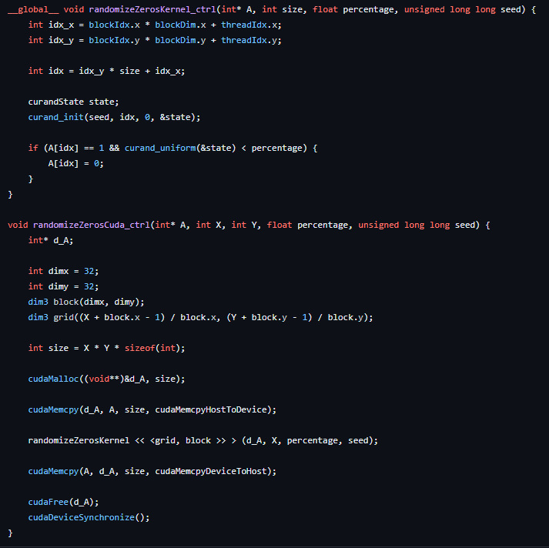
Step 2a: Array Randomizer - control
Does not utilize shared memory and instead performs randomizer on global memory directly

Slide 7
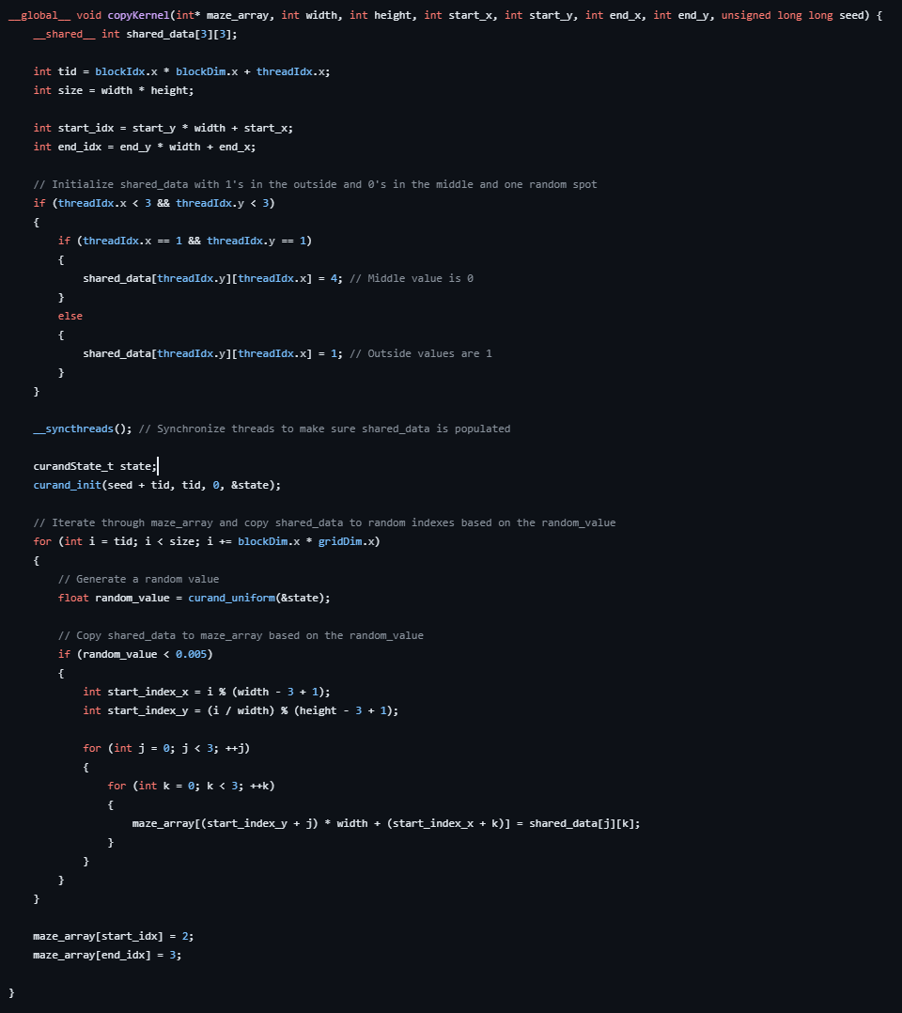
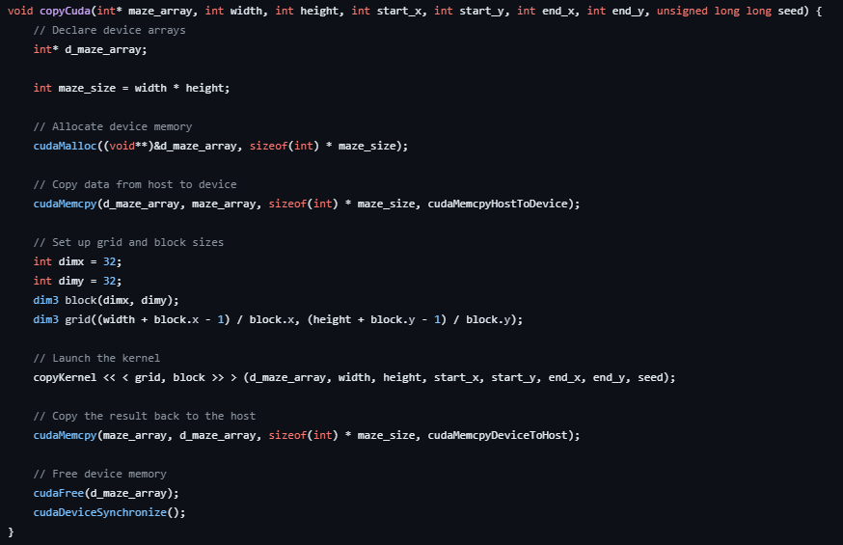
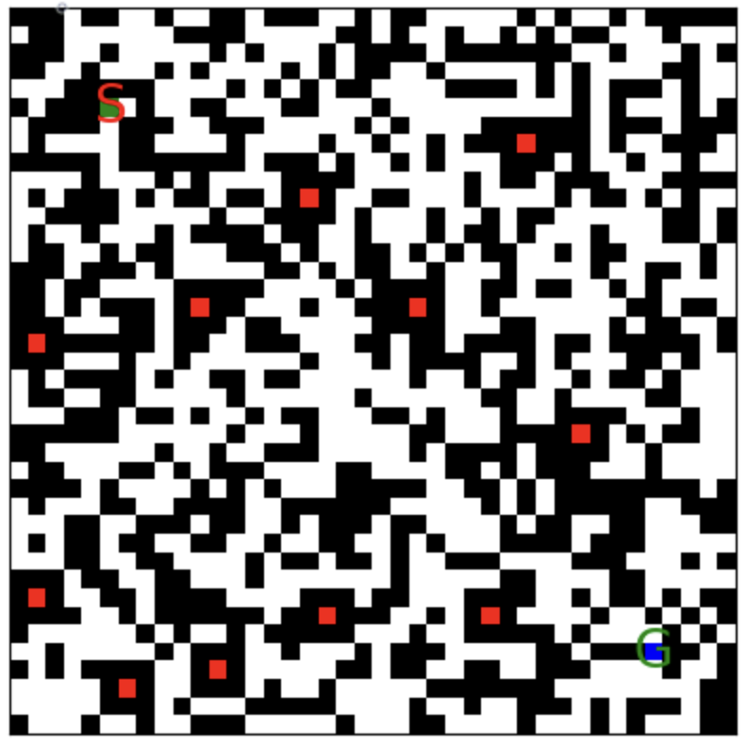
Step 3: Feature generation
Kernel adds features or arrays to maze template
Feature array is saved into shared memory and is copied to random points in the maze rather than utilizing global memory to hold both the maze and feature array

Slide 8
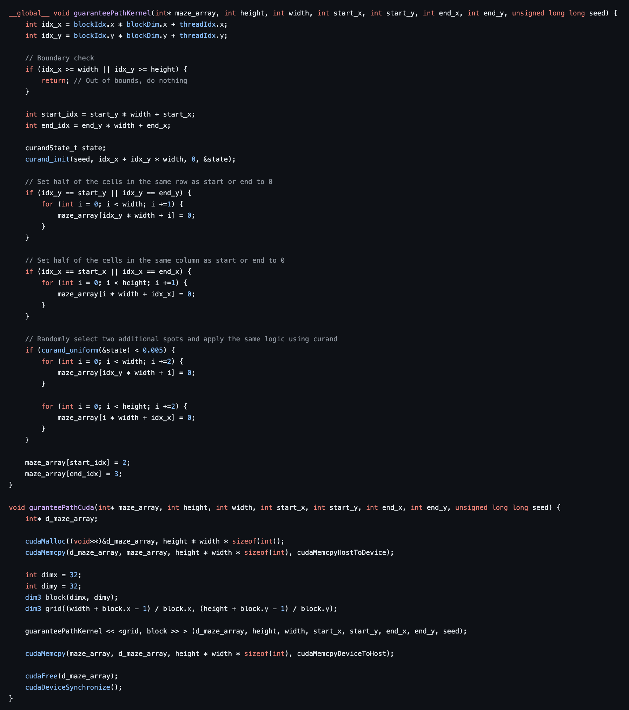
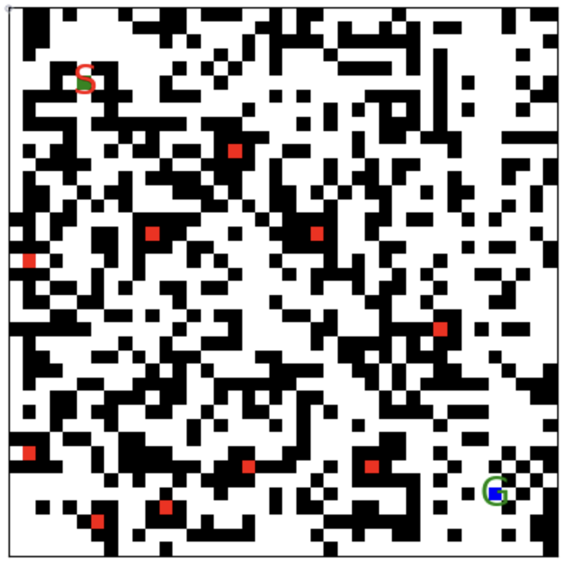
Step 4: Guarantee Path
Kernel picks start and end points as well as random points in maze array to convert indexes within the same row and column as current index to 0
Only applies to every second index to avoid full rows and columns of 0 when random indices are chosen

Slide 9
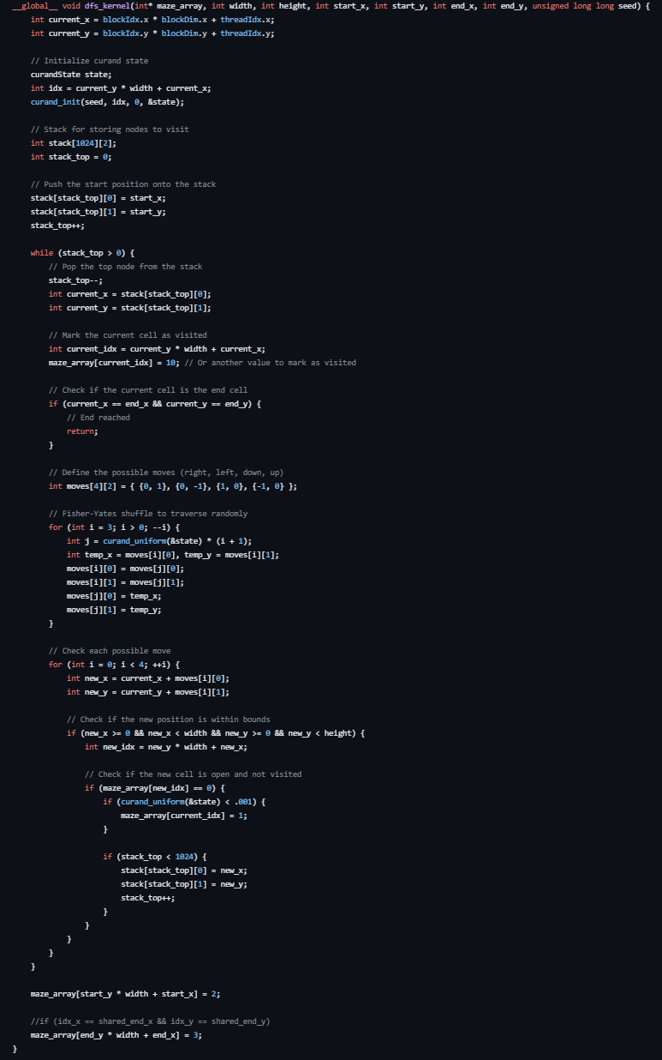
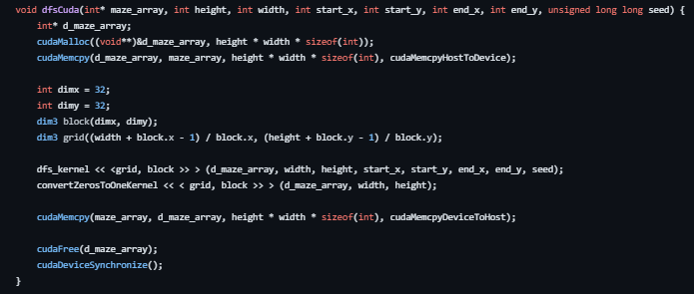
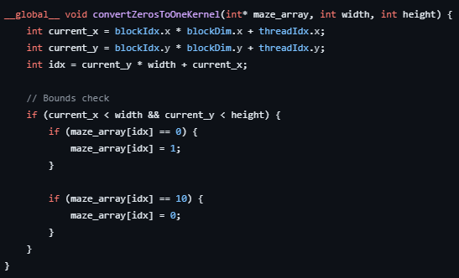
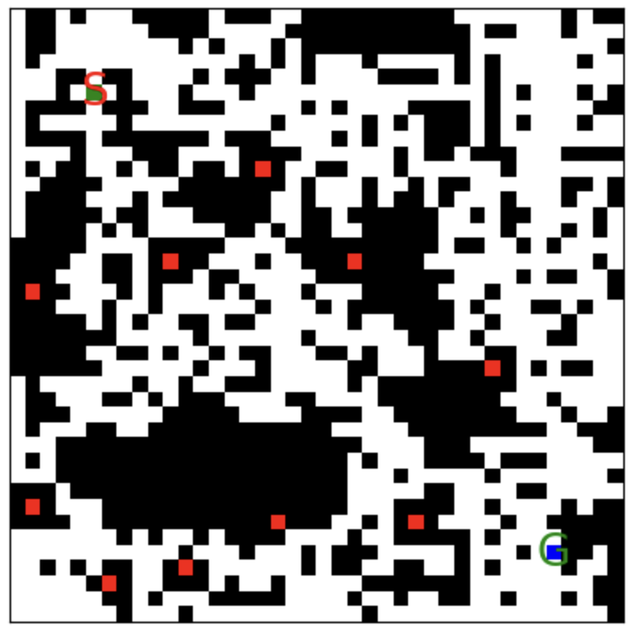
Step 5: DFS terrain modifier
Utilizes stack for each thread to have multiple DFS traversals occurring in parallel
Acts as a way to confirm if path to end goal is reachable
Kernel “walks” through maze by searching for 0 and leaving 10 at cells it has visited
Acts as a method to create realistic terrain and other features
Once complete, all 0’s are converted to 1 and all 10’s are converted to 0
This leaves behind only the areas that can access the end while closing off areas that the DFS algorithm couldn’t reach

Slide 10
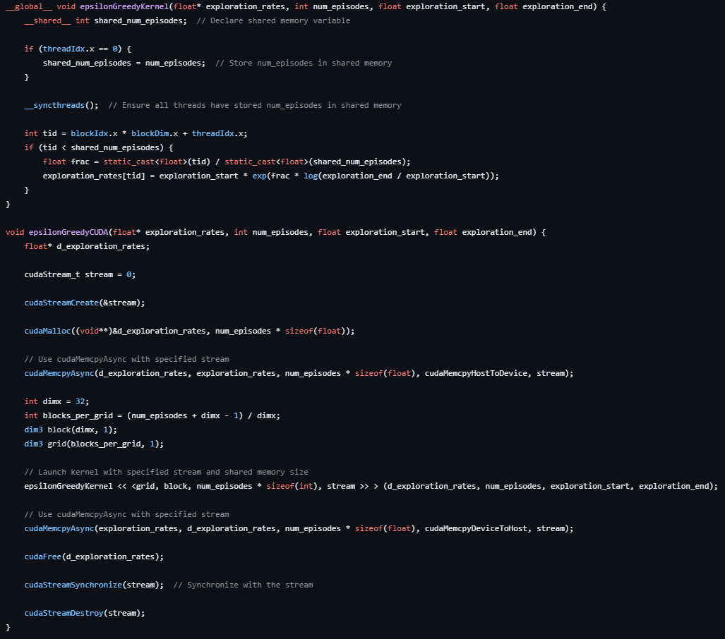
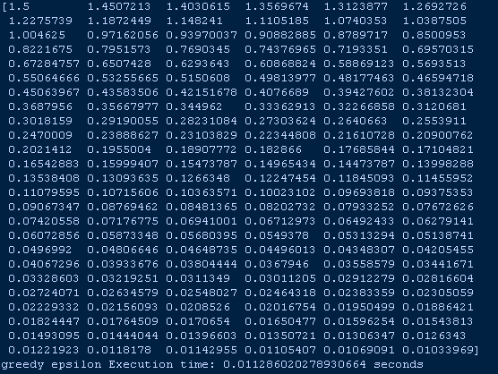
Step 6: Epsilon Rates calculation
Kernel that calculates Epsilon rates to be used for learning in Q-learning algorithm
Utilizes cudaMemcpyAsync with stream to allow for asynchronous loading of data and running of kernel
Is most useful when episode length is long
Initialized only once since all variables are known at the onset of running Q-learning algorithm
Exploration start and end
Number of episodes

Slide 11
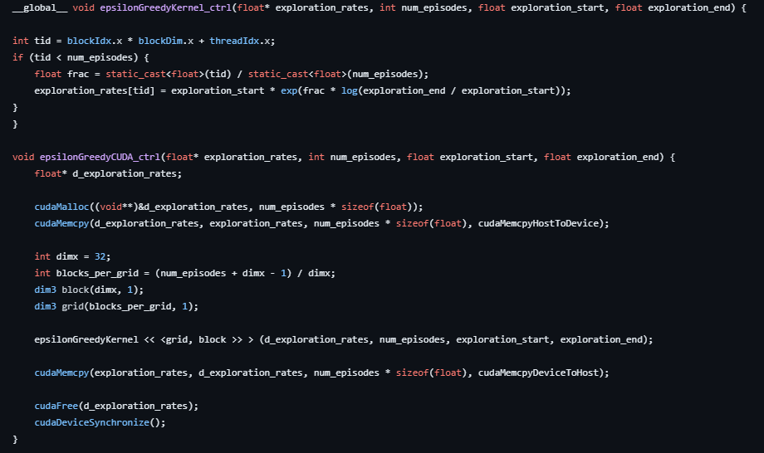
Step 6a: Epsilon Rates calculation - control
This kernel does not utilize asynchronous loading or shared memory usage

Slide 12
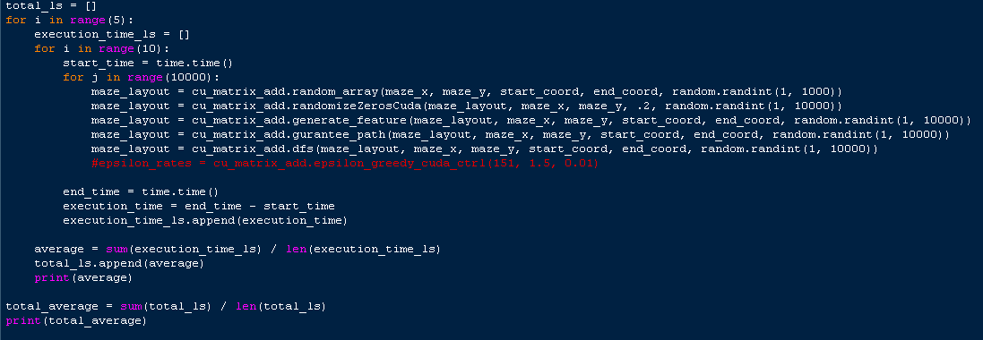
Comparison Testing Parameters
Found average time to complete pipeline or function for different generation amounts
Would run the pipeline or function for the specified generation amount 10 times, acquiring the average time it took to complete the test for each iteration out the 10
This was done 5 times to acquire 5 average times with a single average time being calculated to give the final result
Additional testing was done on individual functions to compare between basic kernel speed vs kernels with asynchronous loading and shared memory
All tests were done on 40x40 mazes with identical start and end positions
Epsilon_rates function was not included in full pipeline since it is not apart of maze generation and only needs to be initialized once in the beginning of using RL agent

Slide 13
Control times
Complete Comparison - Iterations
Experimental times
10 | 100 | 1000 | 10000
5.94 ms | 41.25 ms | 4.08 s | 36.96 s
3.91 ms | 38.44 ms | 3.91 s | 37.11 s
3.91 ms | 38.44 ms | 3.88 s | 36.82 s
3.75 ms | 38.90 ms | 3.88 s | 36.99 s
3.91 ms | 38.75 ms | 3.90 s | 37.47 s
4.28 ms | 39.16 ms | 3.93 s | 37.07 s
10 | 100 | 1000 | 10000
5.00 ms | 40.94 ms | 3.88 s | 36.98 s
3.75 ms | 38.59 ms | 3.88 s | 37.55 s
4.06 ms | 38.75 ms | 3.90 s | 36.64 s
3.91 ms | 38.59 ms | 3.91 s | 37.17 s
3.75 ms | 38.75 ms | 3.97 s | 36.60 s
4.09 ms | 39.12 ms | 3.91 s | 36.99 s

Slide 14
Control times
Random Array Comparison - Iterations
Experimental times
10 | 100 | 1000 | 10000
2.12 ms | 9.18 ms | 71.91 ms | 6.75 s
.92 ms | 7.18 ms | 68.45 ms | 6.86 s
.85 ms | 7.11 ms | 68.39 ms | 6.83 s
.81 ms | 7.10 ms | 69.43 ms | 6.63 s
.72 ms | 7.11 ms | 69.34 ms | 6.88 s
1.08 ms | 7.54 ms | 69.51 ms | 6.79 s
10 | 100 | 1000 | 10000
2.14 ms | 9.05 ms | 70.52 ms | 6.76 s
1.02 ms | 7.11 ms | 68.68 ms | 6.72 s
.73 ms | 7.16 ms | 68.00 ms | 6.67 s
.74 ms | 7.09 ms | 68.73 ms | 6.72 s
.72 ms | 7.07 ms | 68.46 ms | 6.70 s
1.07 ms | 7.50 ms | 68.88 ms | 6.71 s

Slide 15
Control times
Random Zeroes comparison – Iterations
Experimental times
10 | 100 | 1000 | 10000
1.05 ms | 7.89 ms | 70.62 ms | 6.80 s
.93 ms | 6.87 ms | 69.68 ms | 6.91 s
.72 ms | 6.86 ms | 69.18 ms | 6.86 s
.72 ms | 6.78 ms | 69.58 ms | 6.68 s
.72 ms | 6.88 ms | 69.38 ms | 6.81 s
.83 ms | 7.06 ms | 69.69 ms | 6.81 s
10 | 100 | 1000 | 10000
.99 ms | 7.72 ms | 69.12 ms | 6.86 s
.90 ms | 6.78 ms | 68.64 ms | 6.87 s
.70 ms | 6.80 ms | 69.03 ms | 6.88 s
.70 ms | 6.82 ms | 69.68 ms | 6.66 s
.69 ms | 6.85 ms | 69.93 ms | 6.74 s
.80 ms | 6.99 ms | 69.28 ms | 6.80

Slide 16
Control times
Epsilon greedy comparison - episodes
Experimental times
10 | 100 | 1000 | 10000
.030 ms | .031 ms | .032 ms | .031 ms
.028 ms | .027 ms | .028 ms | .030 ms
.027 ms | .028 ms | .028 ms | .029 ms
.029 ms | .029 ms | .029 ms | .030 ms
.028 ms | .028 ms | .029 ms | .030 ms
.028 ms | .029 ms | .029 ms | .030 ms
10 | 100 | 1000 | 10000
.031 ms | .031 ms | .031 ms | .031 ms
.027 ms | .028 ms | .028 ms | .030 ms
.029 ms | .027 ms | .028 ms | .031 ms
.028 ms | .029 ms | .029 ms | .031 ms
.027 ms | .028 ms | .027 ms | .030 ms
.028 ms | .028 ms | .029 ms | .031 ms

Slide 17
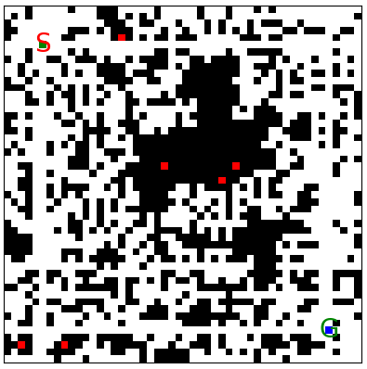
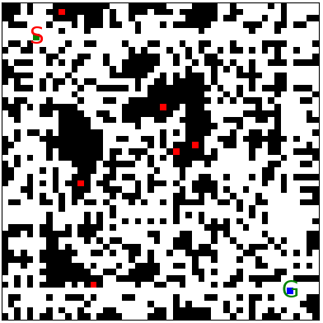
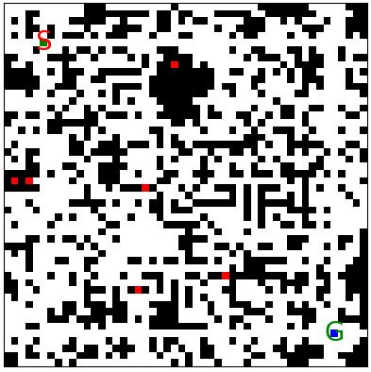
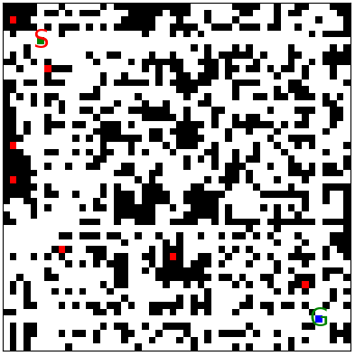
Conclusion and Final Thoughts
Overall, Utilizing CUDA and its features was able to speed up generation of mazes in majority of cases
Ways to improve:
Find way to parallelize entire workflow so that blocks can be generated at one time and then concatenated together to form one giant maze with features and intricate paths
Add additional parameters that use can adjust
Find better ways to ensure path from start to end point
Brute force method works for majority/all of cases depending on usage in maze generation pipeline but can skew data when running models with mazes

